Slide 1
Digital Management Application

Slide 2
Inception Phase
Set up meetings
Availability
Began research
Prototype UI
Identify Risks

Slide 3
Elaboration Phase
Expanded upon work done in inception phase
Requirements
System Requirements Specification
Architecture
Software Architecture Document
Risk Analysis
Risk Management Document
Software Management Plan

Slide 4
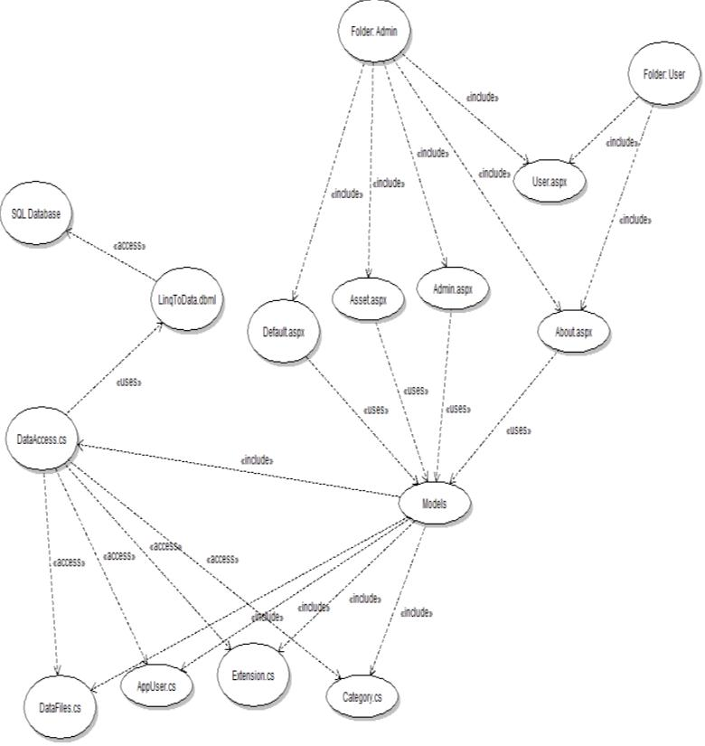
Construction Phase

Slide 5
Transition Phase
Reports
File types

